Slide 1


lesson 4
  Alternative Methods
Of Input

Slide 2
This lesson includes the following sections:
    Devices for the Hand
    Optical Input Devices
    Audio-Visual (Multimedia) Input Devices

Slide 3
Alternative Input Devices –
Devices for the Hand
Pens
Touch Screens
Game Controllers

Slide 4
Devices for the Hand - Pens
With a pen-based system, you use an electronic pen to write on the screen and choose commands.
Pens are common input devices for handheld computers, like “personal digital assistants (PDAs).”
Pens are handy for making notes or selecting commands, not for inputting a lot of text.

Slide 5
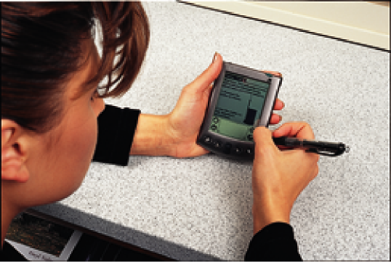
The user can point, tap, draw and write on the computer’s screen with a pen.

Slide 6
Devices for the Hand - Touch Screens
Touch-screen systems accept input directly through the monitor.
Touch screens use sensors to detect the touch of a finger. They are useful where environmental conditions prohibit the use of a keyboard or mouse.
Touch-screen systems are useful for selecting options from menus.

Slide 7
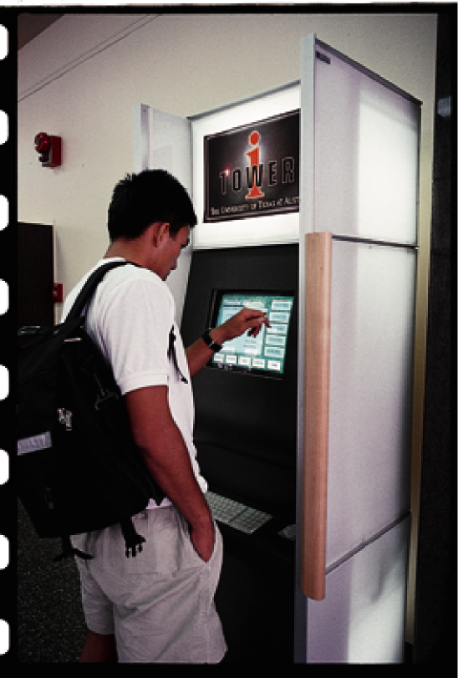

Slide 8
Devices for the Hand - Game Controllers
The two primary types of game controllers are joysticks and game pads.
Game pads usually provide controls for each hand.
Joysticks are popular for flight simulator and driving games.

Slide 9


Slide 10
Alternative Input Devices –
Optical Input Devices
Bar Code Readers
Image Scanners and OCR

Slide 11
Optical Input Devices - Bar Code Readers
Bar code readers can read bar codes—patterns of printed bars.
The reader emits light, which reflects off the bar code and into a detector in the reader. The detector translates the code into numbers.
Flatbed bar code readers are commonly found in supermarkets. Courier services often use handheld readers.

Slide 12
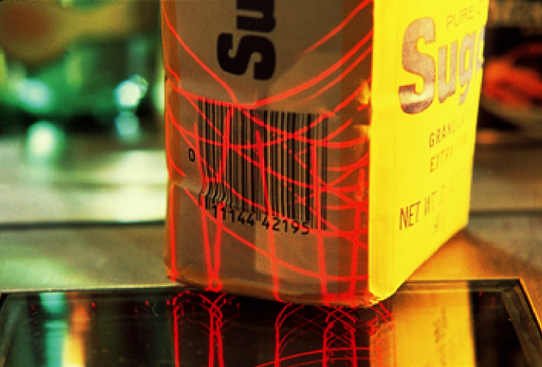
Bar code readers commonly track sales in retail stores

Slide 13
Optical Input Devices –
Image Scanners and OCR
Image scanners digitize printed images for storage and
manipulation in a computer.
A scanner shines light onto the image and interprets the reflection.
Optical character recognition (OCR) software translates scanned text into editable electronic documents.

Slide 14
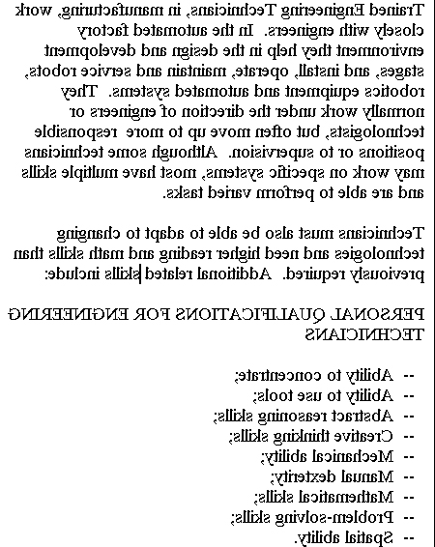
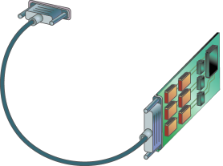
Document
being
scanned
Converts
diode signals
to numbers
To computer
Light source, lens
and diode array

Slide 15
Alternative Input Devices –
Audio-Visual (Multimedia) Input Devices
Microphones and Speech Recognition
Video Input

Slide 16
Audio-Visual (Multimedia) Input Devices -
Microphones and Speech Recognition
Microphones can accept auditory input. A microphone requires a sound card in the PC.
A sound card can digitize analog sound signals, and convert digital sound signals to analog form.
With speech recognition software, you can use your microphone to dictate text, navigate programs, and choose commands.

Slide 17
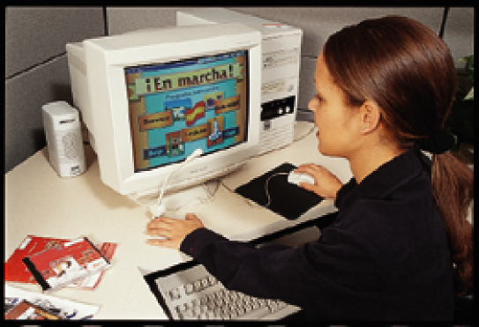
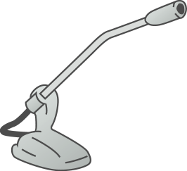
Analog Sound Signals
Digital Audio Output
[electrical signals] (ex. 11100011) to
computer
Analog Signals are Digitized

Slide 18
Audio-Visual (Multimedia) Input Devices –
Video Input
PC video cameras digitize full-motion images.
Digital cameras capture still images.
These cameras break images into pixels and store data about each pixel.
Video images may be compressed to use less memory and storage space.

Slide 19
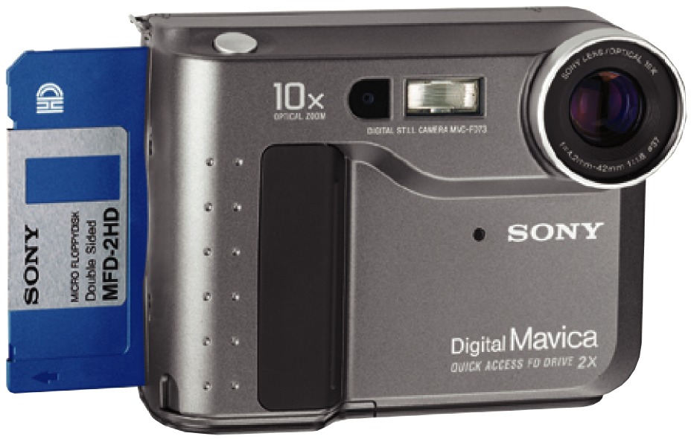

Slide 20
lesson 4 Review
List two reasons why some computer users prefer alternative methods of input over a standard keyboard or mouse.
List three categories of alternative input devices.
List two type of optical input devices and describe their uses.
Describe the uses for speech-recognition systems.
Identify two types of video input devices and their uses.

